Slide 1
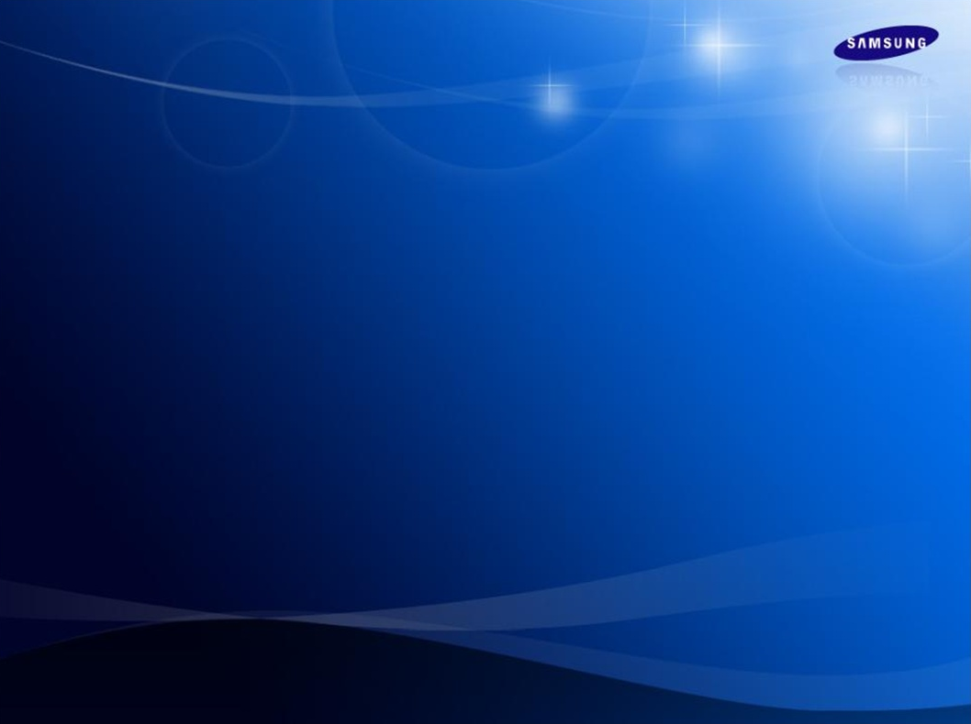
European Reference Projects
European Air Conditioning Operation

Slide 2

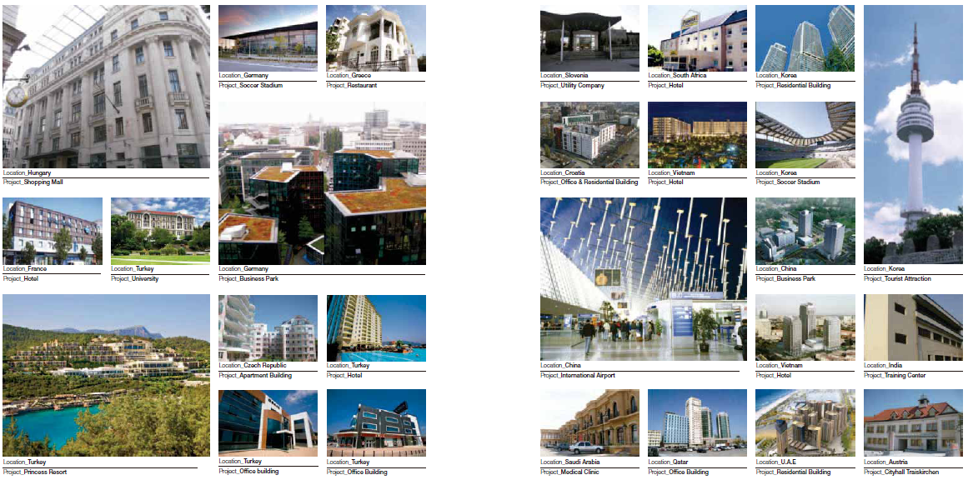
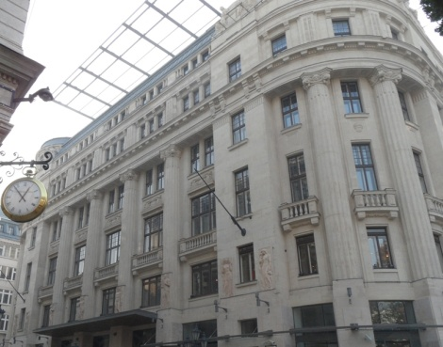
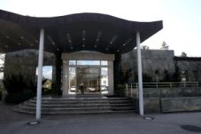
Our DVM systems have proved their performance and reliability all over the world

Slide 3

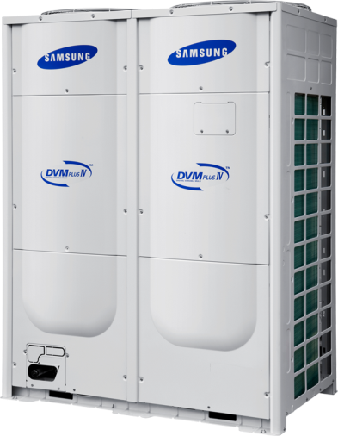

European
DVM Reference Projects

Slide 4

Office
Hotel
Retail
Baltic Business Park
ECCN
PGE Rzeszow
Baxter Generali
PFRON
Murawa Office Park
Swissport
Jornal Ocasiao
Sheraton Edinburgh
Sterne Plus Hotel
Parkalgar Radisson
De Vere Grand Hotel
Hotel La Pisana
BLOC Hotel
Leonardo Hotel
Hotel Caravelas
Vaci 1, ORCO
IKEA
Bavier Shopping Centre
New Look
Liegenschaft Albstrasse
Sport & Leisure
Education
Public Building
Merkur Spielothek
Rose Bowl
Church of England School
New College Swindon
Accademia della Crusca
Southend Airport
Kecskemet Police Station
VAM Design Center
Healthcare
Katharinum Center

Slide 5
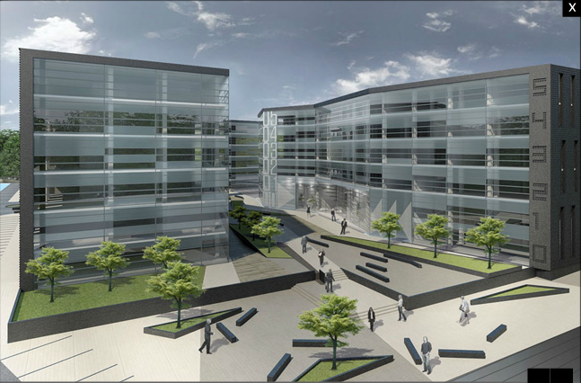

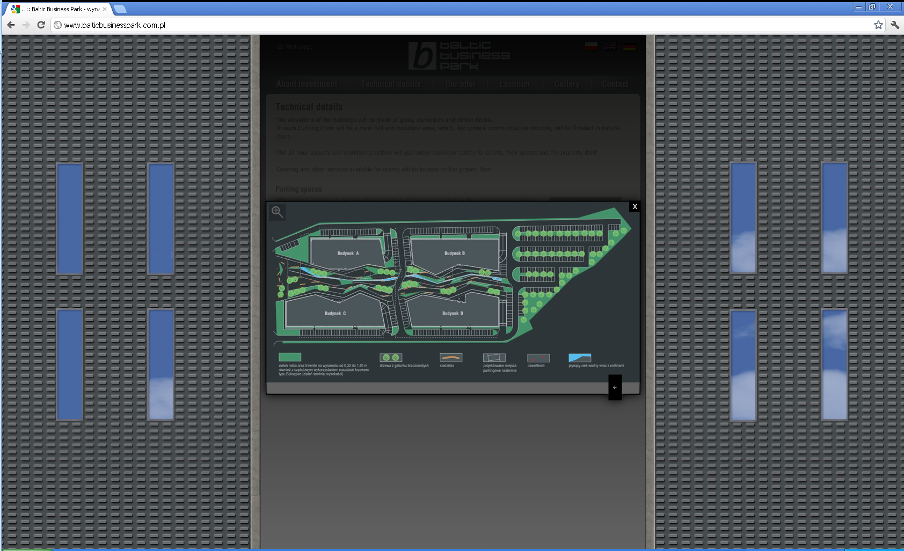
Baltic Business Park
Information
Project | Office Park
Location | Szczecin, Poland
Date of Completion | Q3 2012
Size | 26,000 m²
Value | € 1,000k
Equipment Selection
Equipment | Model Type | Quantity
Outdoor Units | - DVM PLUS IV - CAC - AHU (via AHU Kit) | 46 17 8
Indoor Units | - 4Way Cassette S | 611
Control Solution | - 3x DMS 2

Slide 6
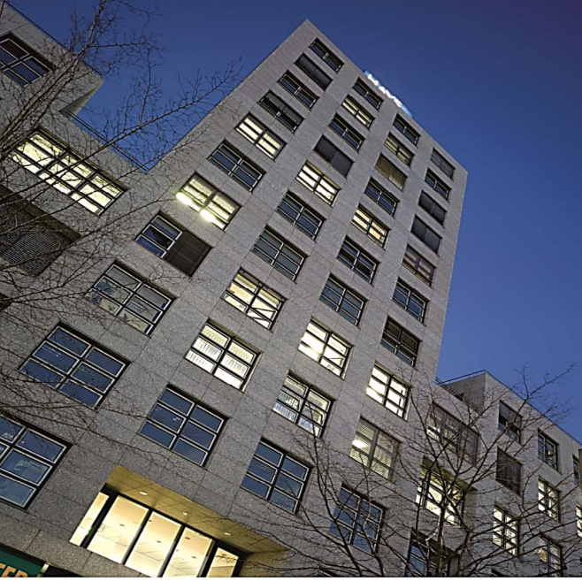
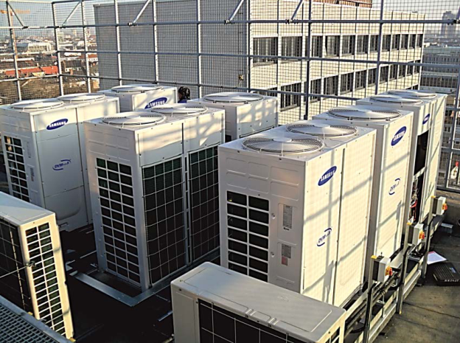
ECCN
Information
Project | Offices
Location | Mannheim, Germany
Date of Completion | March, 2012
Size | 9,000 m²
Value | € 210k
Equipment Selection
Equipment | Model Type | Quantity
Outdoor Units | - DVM PLUS IV | 10
Indoor Units | - 1Way Cassette - 2Way Cassette - 4Way Cassette - Neo Forte Wall mount - Slim Duct | 270 2 10 1 1
Control Solution | -DMS 2

Slide 7
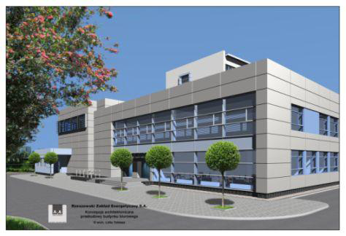
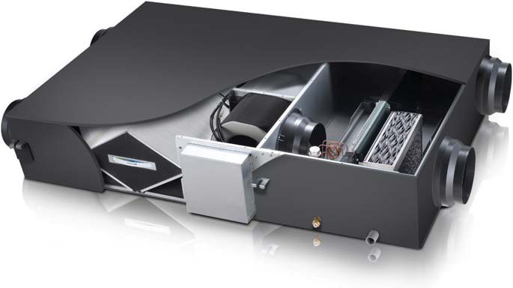
PGE Rzeszów
Information
Project | Offices
Location | Poznan, Poland
Date of Completion | Q3 2011
Size | 15,000 m²
Value | € 170k
Equipment Selection
Equipment | Model Type | Quantity
Outdoor Units | - DVM PLUS IV | 17
Indoor Units | - Console - Slim Duct - ERV | 215
Control Solution | - DMS 2 - S-NET 3

Slide 8
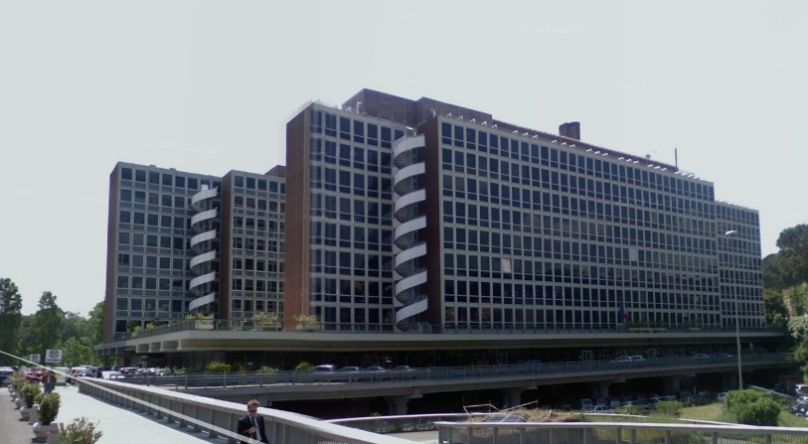
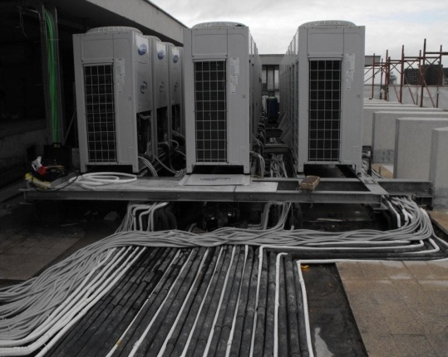
Baxter Generali
Information
Project | Office
Location | Rome, Italy
Date of Completion | February 2009
Size | 10,000 m²
Value | € 143k
Equipment Selection
Equipment | Model Type | Quantity
Outdoor Units | - DVM PLUS II | 30
Indoor Units | - Console - Slim Duct - ERV | 42 56 28
Control Solution | - 98 * Premium Remote Controller - DMS

Slide 9
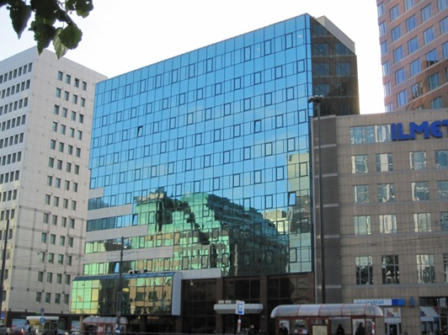
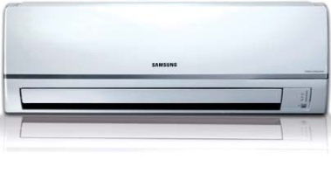
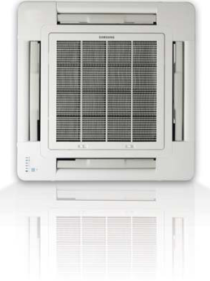
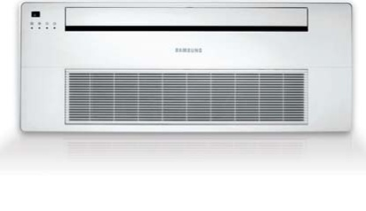
PFRON
Information
Project | PFRON
Location | Warsaw, Poland
Date of Completion | 2010
Size | 4,525 m²
Value | € 150k
Equipment Selection
Equipment | Model Type | Quantity
Outdoor Units | - DVM PLUS III | 22
Indoor Units | - 4 Way - Slim 1 Way - Neo Forte Wall Mounted | 215
Control Solution | - DMS2 - Window relays - Electric power use limit combined with DMS2 control logic management

Slide 10
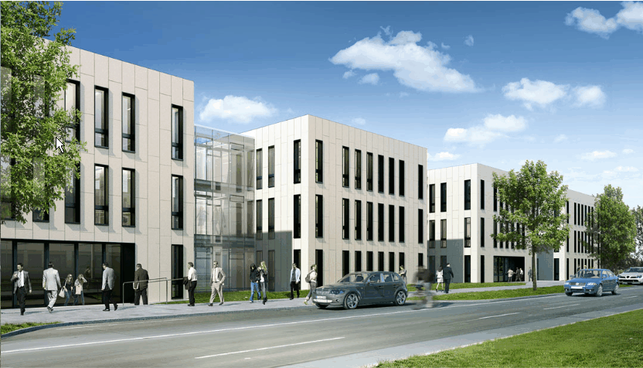
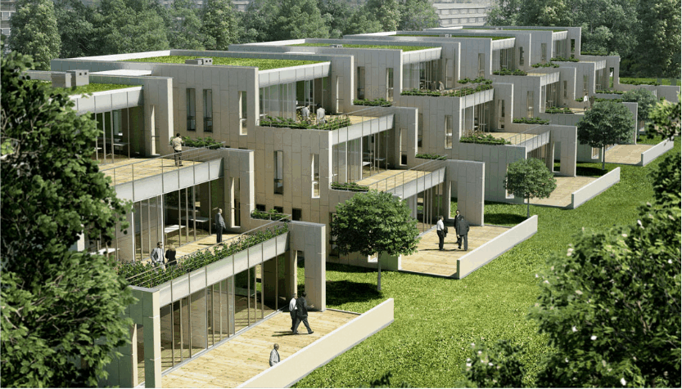
Murawa Office Park
Information
Project | Office Park
Location | Poznan, Poland
Date of Completion | December, 2010
Size | 7,500 m²
Value | € 205k
Equipment Selection
Equipment | Model Type | Quantity
Outdoor Units | - DVM PLUS III HR | 10
Indoor Units | - Duct - 4Way Cassette - Vivace Wall Mounted | 151
Control Solution | - Lonworks Interface

Slide 11
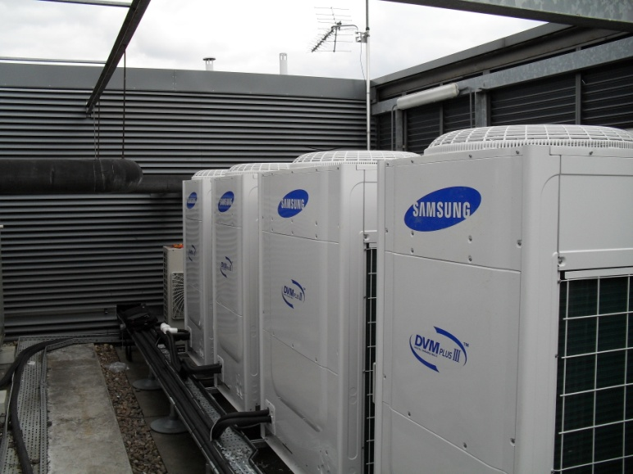
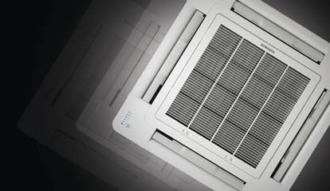
Swissport
Information
Project | Office
Location | London, UK
Date of Completion | 2011
Size | 1,200 m²
Value | € 182k
Photo 1 ; main photo
Equipment Selection
Equipment | Model Type | Quantity
Outdoor Units | - DVM PLUS II HR | 7
Indoor Units | - 4 Way | 64
Control Solution | - DMS

Slide 12
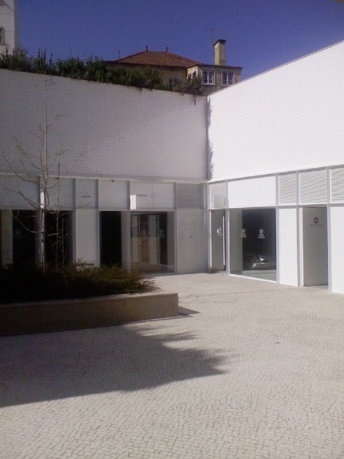
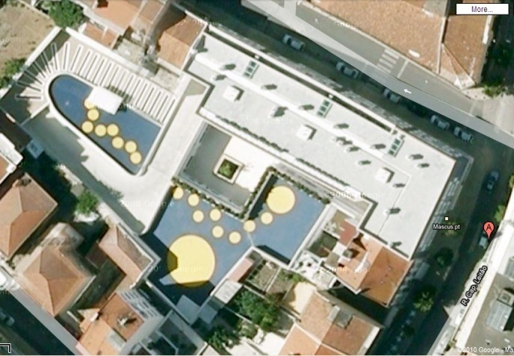
Jornal Ocasião
Information
Project | Office
Location | Lisbon, Portugal
Date of Completion | May 2009
Size | 3,700 m²
Value | € 41k
Equipment Selection
Equipment | Model Type | Quantity
Outdoor Units | - DVM PLUS III | 4
Indoor Units | - Duct | 24
Control Solution | - Centralized Controller

Slide 13
Office
Hotel
Retail
Baltic Business Park
ECCN
PGE Rzeszow
Baxter Generali
PFRON
Murawa Office Park
Swissport
Jornal Ocasiao
Sheraton Edinburgh
Sterne Plus Hotel
Parkalgar Radisson
De Vere Grand Hotel
Hotel La Pisana
BLOC Hotel
Leonardo Hotel
Hotel Caravelas
Vaci 1, ORCO
IKEA
Bavier Shopping Centre
New Look
Liegenschaft Albstrasse
Sport & Leisure
Education
Public Building
Merkur Spielothek
Rose Bowl
Church of England School
New College Swindon
Accademia della Crusca
Southend Airport
Kecskemet Police Station
VAM Design Center
Healthcare
Katharinum Center

Slide 14
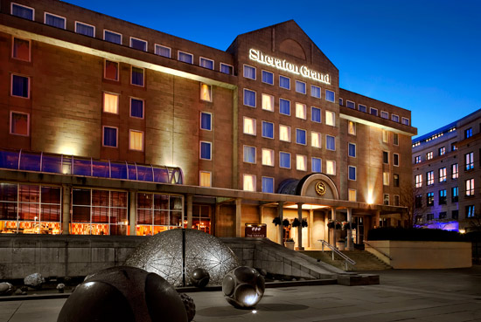
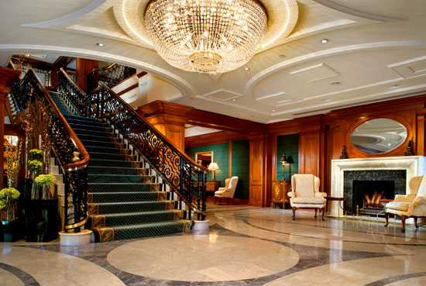
Sheraton Edinburgh Hotel *****
Information
Project | 5 star Hotel (269 rooms)
Location | Edinburgh, UK
Date of Completion | Q3, 2010
Size | 11,500 m²
Value | € 220k
Equipment Selection
Equipment | Model Type | Quantity
Outdoor Units | - DVM PLUS II HR | 25
Indoor Units | - Slim Duct | 285
Control Solution | - DMS 2

Slide 15
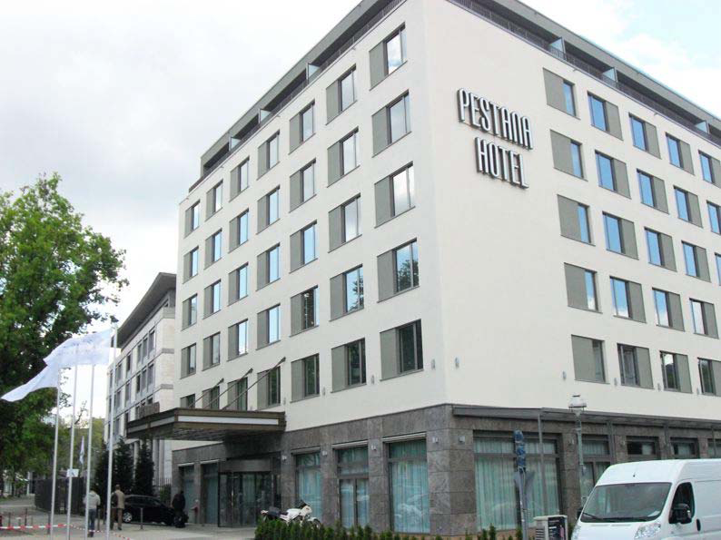
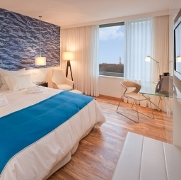
Sterne Plus Hotel *****
Information
Project | 5 star Hotel (142 rooms)
Location | Berlin, Germany
Date of Completion | February, 2011
Size | 1,700 m²
Value | € 115k
Equipment Selection
Equipment | Model Type | Quantity
Outdoor Units | - DVM PLUS III HR - DVM PLUS III | 6 5
Indoor Units | - Slim Duct - AHU Kit | 142 9
Control Solution | - DMS 2 - Fidelio

Slide 16
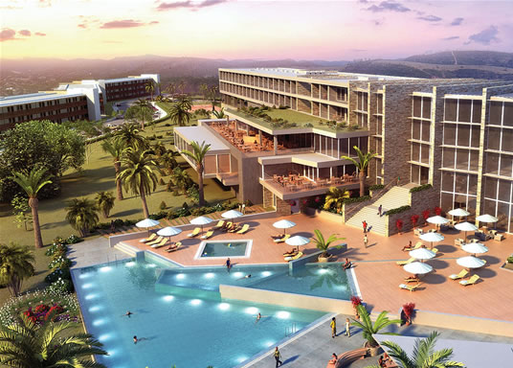
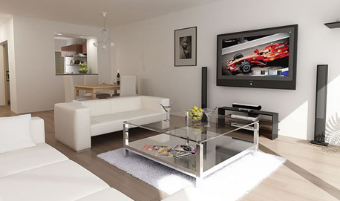
Parkalgar Radisson Hotel Spa & Resort ****
Information
Project | 5 star Hotel (208 rooms & 166 apartments)
Location | Portimão, Portugal
Date of Completion | September 2011
Size | 16,000 m²
Value | € 450k
Equipment Selection
Equipment | Model Type | Quantity
Outdoor Units | - DVM PLUS IV - FJM | 19 166
Indoor Units | - Ducts (hotel) - Wall Mounted(apartments) | 254 483
Control Solution | - DMS 2 - LONworks

Slide 17
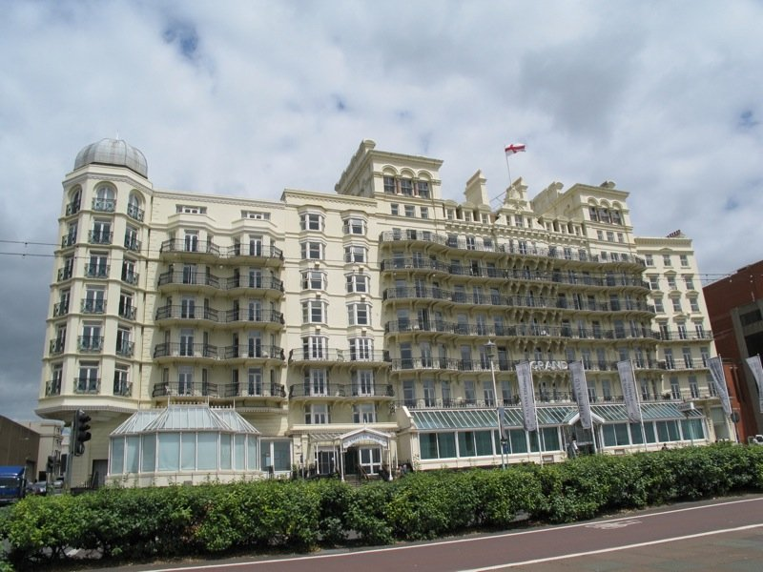
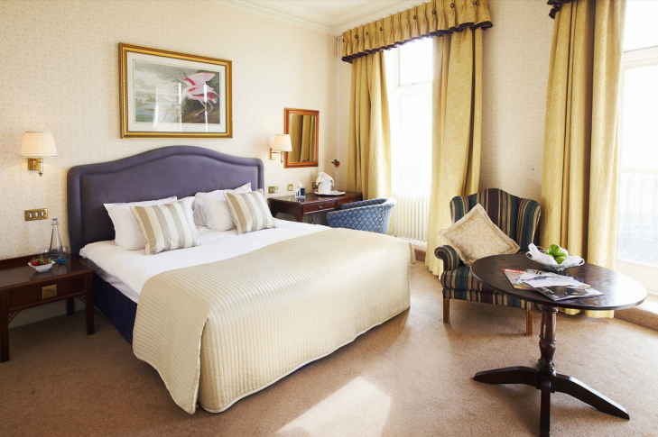
De Vere Grand Hotel ****
Information
Project | 4 star Hotel (204 rooms)
Location | Brighton, UK
Date of Completion | Q3, 2011
Size | 8,300 m²
Value | € 210k
Equipment Selection
Equipment | Model Type | Quantity
Outdoor Units | - DVM PLUS VI HR | 21
Indoor Units | - Neo-Forte Wall mounted | 208
Control Solution | - Wired Remote Controllers

Slide 18
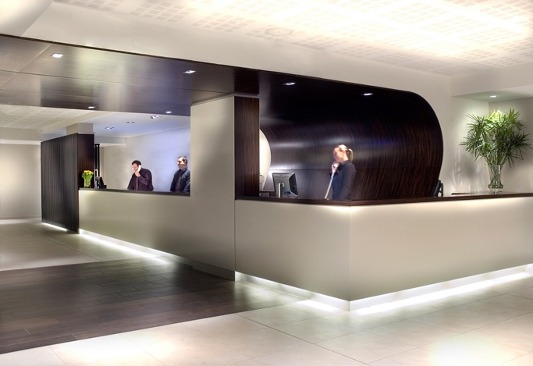
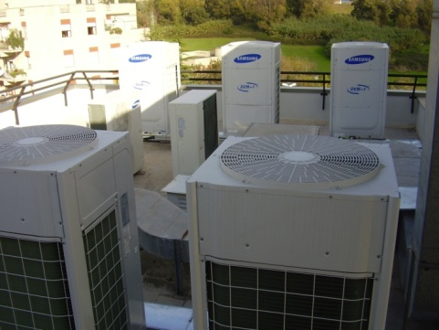
Hotel La Pisana ****
Information
Project | 4 star Hotel (211 rooms)
Location | Rome, Italy
Date of Completion | 2007
Size | 1,500 m²
Value | € 93k
Equipment Selection
Equipment | Model Type | Quantity
Outdoor Units | - DVM PLUS II HR | 10
Indoor Units | - Mini 4Way Cassette - Slim Duct | 150
Control Solution | - Lonworks

Slide 19
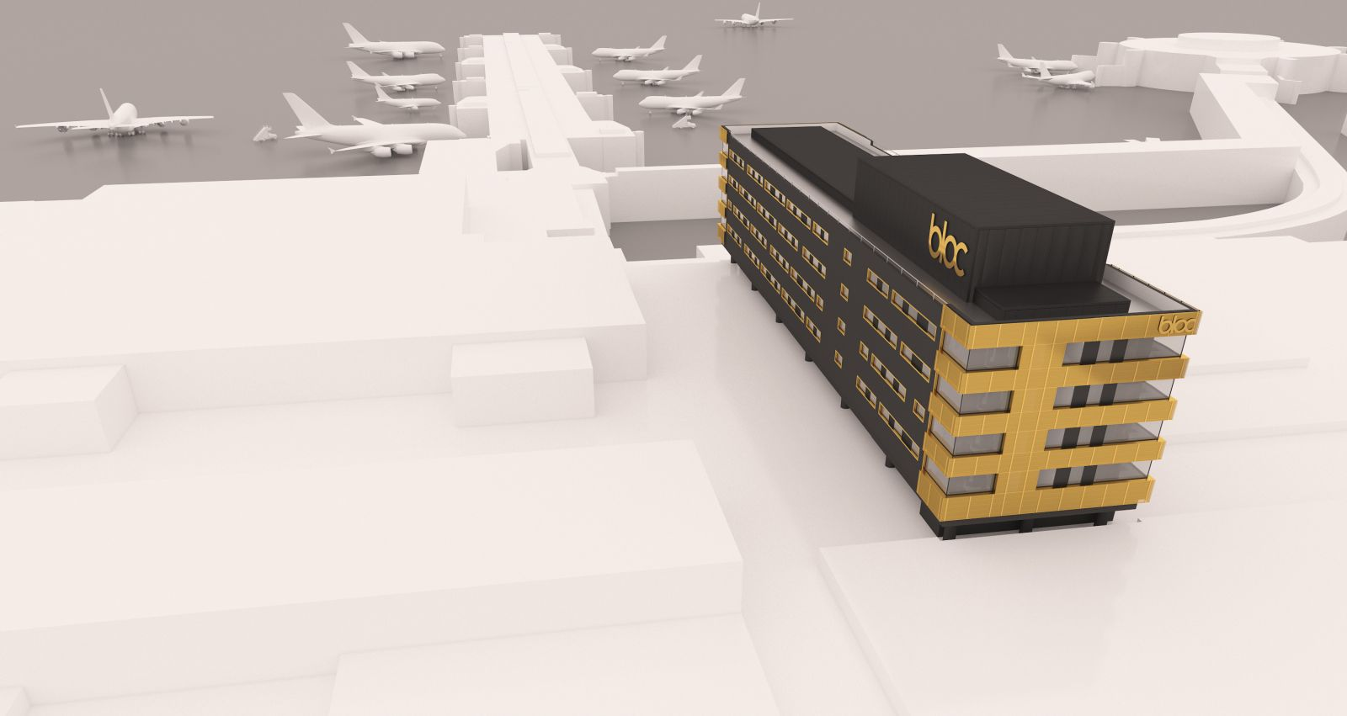
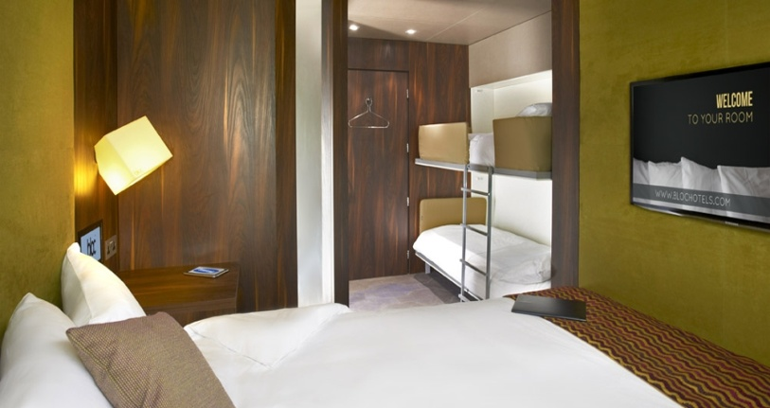
BLOC Hotel
Information
Project | Boutique Hotel (240 rooms)
Location | Gatwick Airport, UK
Date of Completion | 2013
Size | 5,000 m²
Value | € 250k
Equipment Selection
Equipment | Model Type | Quantity
Outdoor Units | - DVM PLUS IV | 15
Indoor Units | - Slim Duct | 248
Control Solution | - DMS 2

Slide 20
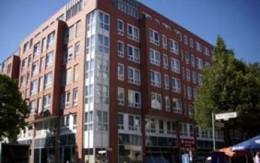
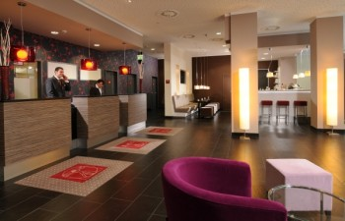
Leonardo Hotel ***
Information
Project | 3 star Hotel (274 rooms)
Location | Berlin, Germany
Date of Completion | September 2009
Size | 14,000 m²
Value | € 180k
Equipment Selection
Equipment | Model Type | Quantity
Outdoor Units | - DVM PLUS III HR | 14
Indoor Units | - Duct | 274
Control Solution | - Individual Wired Remote Controllers - DMS

Slide 21
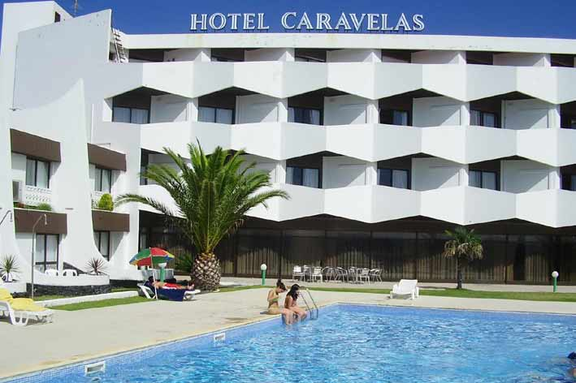
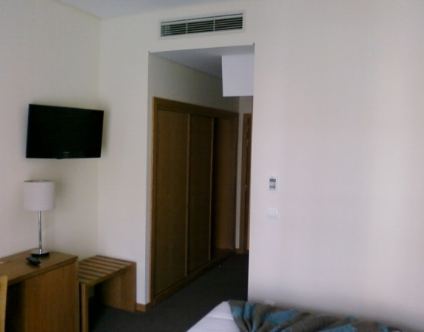
Hotel Caravelas ***
Information
Project | 3 star Hotel (167 rooms)
Location | Pico Island, Azores, Portugal
Date of Completion | August 2009
Size | 15,000 m²
Value | € 143k
Equipment Selection
Equipment | Model Type | Quantity
Outdoor Units | - DVM PLUS III | 16
Indoor Units | - Slim Duct - Wall Mounted - 4Way Cassette | 157
Control Solution | - DMS - S-NET Mini

Slide 22
Office
Hotel
Retail
Baltic Business Park
ECCN
PGE Rzeszow
Baxter Generali
PFRON
Murawa Office Park
Swissport
Jornal Ocasiao
Sheraton Edinburgh
Sterne Plus Hotel
Parkalgar Radisson
De Vere Grand Hotel
Hotel La Pisana
BLOC Hotel
Leonardo Hotel
Hotel Caravelas
Vaci 1, ORCO
IKEA
Bavier Shopping Centre
New Look
Liegenschaft Albstrasse
Sport & Leisure
Education
Public Building
Merkur Spielothek
Rose Bowl
Church of England School
New College Swindon
Accademia della Crusca
Southend Airport
Kecskemet Police Station
VAM Design Center
Healthcare
Katharinum Center

Slide 23
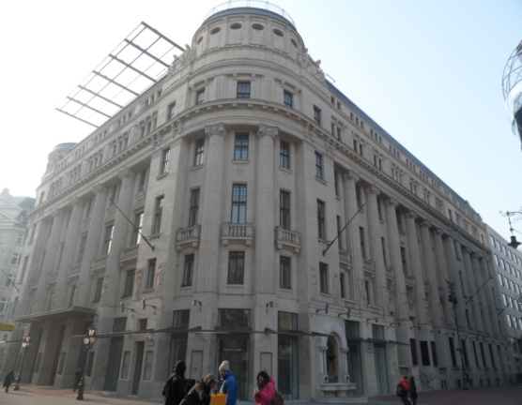
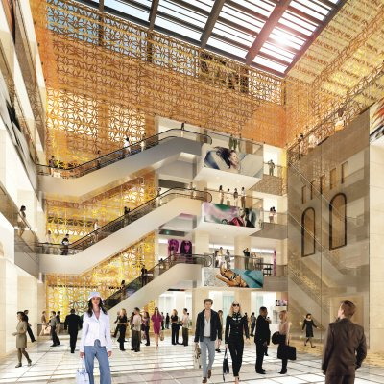
Vaci 1, ORCO
Information
Project | Shopping Mall
Location | Budapest, Hungary
Date of Completion | September 2012
Size | 12,000 m²
Value | € 571k
Equipment Selection
Equipment | Model Type | Quantity
Outdoor Units | - DVM PLUS III HR | 52
Indoor Units | - 4 Way /Duct/Console - Air Handling Units | 300 6
Control Solution | - Centralized Controller - DMS 2 - S-NET 3 - Power Distribution

Slide 24
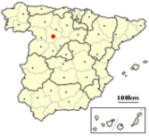
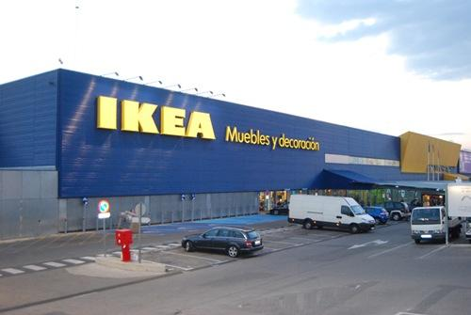
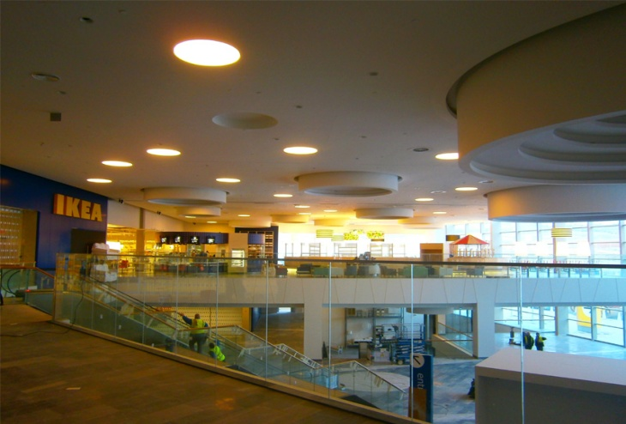
IKEA
Information
Project | Ikea retail store
Location | Valladolid, Spain
Date of Completion | August 2012
Size | 20,700m²
Value | € 201k
Equipment Selection
Equipment | Model Type | Quantity
Outdoor Units
Indoor Units | - ERV | 166
Control Solution | - CO2 sensor - MWR-WE10 wired remote controller

Slide 25
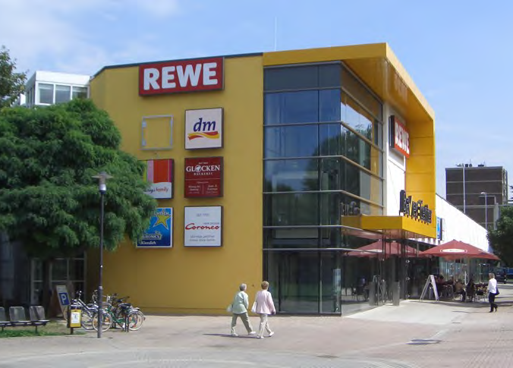
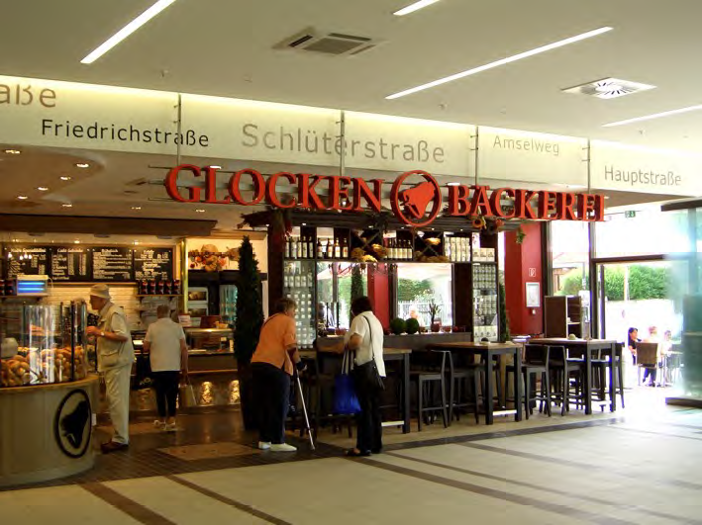
Bavier Shopping Centre
Information
Project | Retail
Location | Erkrath, Germany
Date of Completion | August 2010
Size | 6,000 m²
Value | € 100k
Equipment Selection
Equipment | Model Type | Quantity
Outdoor Units | - DVM PLUS III | 6
Indoor Units | - Mini 4Way Cassette | 30
Control Solution | - Wired remote controller - DMS

Slide 26
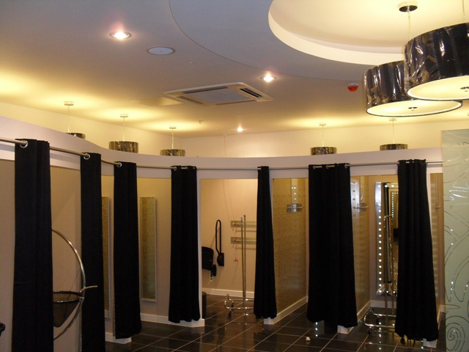
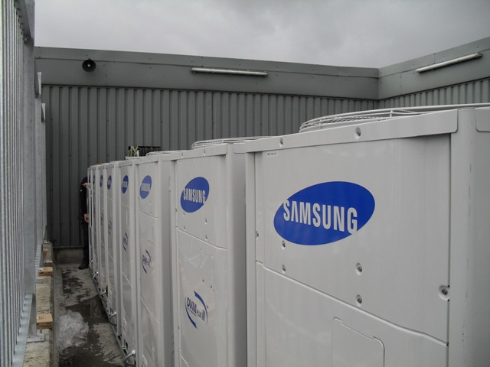
New Look
Information
Project | Retail
Location | Dublin, Ireland
Date of Completion | June 2010
Size | 3,700 m²
Value | € 110k
Equipment Selection
Equipment | Model Type | Quantity
Outdoor Units | - DVM PLUS III HR - CAC | 8 8
Indoor Units | - 4Way Cassette - 1Way Cassette | 28 1
Control Solution | - DMS - S-NET Mini

Slide 27
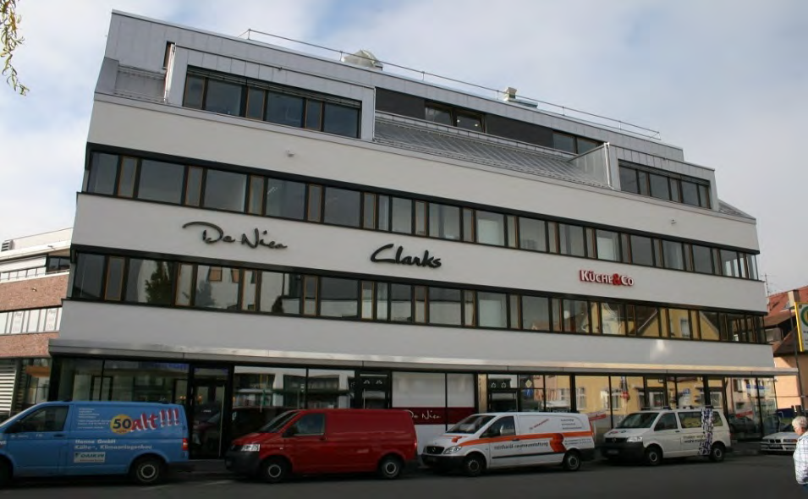
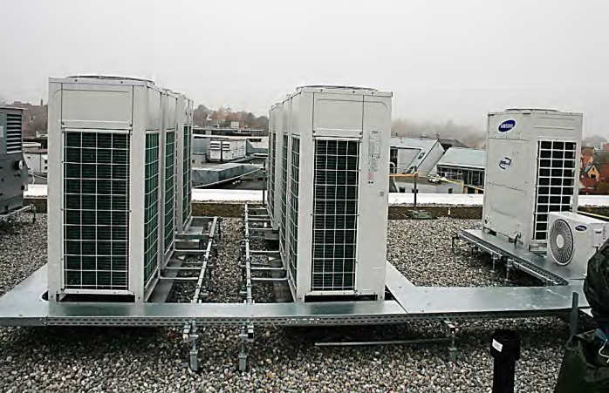
Liegenschaft Albstrasse
Information
Project | Retail
Location | Reutlingen, Germany
Date of Completion | August 2011
Size | 6,000 m²
Value | € 135k
Equipment Selection
Equipment | Model Type | Quantity
Outdoor Units | - DVM PLUS III | 7
Indoor Units | - 4Way Cassette - 1Way Cassette - 2Way Cassette - Wall Mounted | 61 13 2 2
Control Solution | - Wired remote controller - DMS

Slide 28
Office
Hotel
Retail
Baltic Business Park
ECCN
PGE Rzeszow
Baxter Generali
PFRON
Murawa Office Park
Swissport
Jornal Ocasiao
Sheraton Edinburgh
Sterne Plus Hotel
Parkalgar Radisson
De Vere Grand Hotel
Hotel La Pisana
BLOC Hotel
Leonardo Hotel
Hotel Caravelas
Vaci 1, ORCO
IKEA
Bavier Shopping Centre
New Look
Liegenschaft Albstrasse
Sport & Leisure
Education
Public Building
Merkur Spielothek
Rose Bowl
Church of England School
New College Swindon
Accademia della Crusca
Southend Airport
Kecskemet Police Station
VAM Design Center
Healthcare
Katharinum Center

Slide 29


Merkur Spielothek
Information
Project | Leisure
Location | Monheim, Germany
Date of Completion | February 2010
Size | 5,000 m²
Value | € 80k
Equipment Selection
Equipment | Model Type | Quantity
Outdoor Units | - DVM PLUS III HR - Air Handling Unit | 4 5
Indoor Units | - Duct - Mini 4Way Cassette | 19 4
Control Solution | - Centralized Controller - Wired Remote Controllers

Slide 30


Rose Bowl
Information
Project | Leisure
Location | Southampton UK
Date of Completion
Size | 500 m²
Value | € 35k
Equipment Selection
Equipment | Model Type | Quantity
Outdoor Units | - DVM PLUS III - CAC | 2 2
Indoor Units | - Duct - Cassette - Wall Mounted - Energy Recovery Ventilators | 4 10 1 3
Control Solution | - DMS

Slide 31
Office
Hotel
Retail
Baltic Business Park
ECCN
PGE Rzeszow
Baxter Generali
PFRON
Murawa Office Park
Swissport
Jornal Ocasiao
Sheraton Edinburgh
Sterne Plus Hotel
Parkalgar Radisson
De Vere Grand Hotel
Hotel La Pisana
BLOC Hotel
Leonardo Hotel
Hotel Caravelas
Vaci 1, ORCO
IKEA
Bavier Shopping Centre
New Look
Liegenschaft Albstrasse
Sport & Leisure
Education
Public Building
Merkur Spielothek
Rose Bowl
Church of England School
New College Swindon
Accademia della Crusca
Southend Airport
Kecskemet Police Station
VAM Design Center
Healthcare
Katharinum Center

Slide 32


Dagenham Church of England School
Information
Project | Education
Location | Dagenham, UK
Date of Completion | Q4 2011 ~ Q1 2012
Size | 3,700 m²
Value | € 122k
Equipment Selection
Equipment | Model Type | Quantity
Outdoor Units | - DVM PLUS IV HR | 11
Indoor Units | - Cassette | 35
Control Solution | - Wired remote controllers

Slide 33


New College Swindon
Information
Project | Education
Location | Swindon, UK
Date of Completion | August, 2009
Size | 750 m²
Value | € 35k
Equipment Selection
Equipment | Model Type | Quantity
Outdoor Units | - DVM PLUS III HR - Mini DVM | 2 1
Indoor Units | - 4Way Cassette - Wall Mounted | 15 5
Control Solution | - S-NET Mini

Slide 34


Accademia della Crusca
Information
Project | Public library
Location | Florence, Italy
Date of Completion | 2009
Size | 800 m²
Value | € 57k
Equipment Selection
Equipment | Model Type | Quantity
Outdoor Units | - DVM PLUS II | 9
Indoor Units | - Console - Wall Mounted - Ceiling | 62
Control Solution | - DMS - Power Distribution Meter

Slide 35
Office
Hotel
Retail
Baltic Business Park
ECCN
PGE Rzeszow
Baxter Generali
PFRON
Murawa Office Park
Swissport
Jornal Ocasiao
Sheraton Edinburgh
Sterne Plus Hotel
Parkalgar Radisson
De Vere Grand Hotel
Hotel La Pisana
BLOC Hotel
Leonardo Hotel
Hotel Caravelas
Vaci 1, ORCO
IKEA
Bavier Shopping Centre
New Look
Liegenschaft Albstrasse
Sport & Leisure
Education
Public Building
Merkur Spielothek
Rose Bowl
Church of England School
New College Swindon
Accademia della Crusca
Southend Airport
Kecskemet Police Station
VAM Design Center
Healthcare
Katharinum Center

Slide 36


Southend Airport
Information
Project | Airport
Location | London, UK
Date of Completion | Q2, 2011
Size | 4,500 m²
Value | € 320k
Equipment Selection
Equipment | Model Type | Quantity
Outdoor Units | - DVM PLUS III | 18
Indoor Units | - Duct - Wall Mounted | 47
Control Solution | - Wired Remote Controllers

Slide 37


Kecskemet Police Station
Information
Project | Public Building
Location | Kecskemet, Hungary
Date of Completion | Q2, 2012
Size | 15,000 m²
Value | € 320k
Equipment Selection
Equipment | Model Type | Quantity
Outdoor Units | - DVM PLUS IV | 23
Indoor Units | - Console | 358
Control Solution | - DMS 2 - S-NET Mini

Slide 38


VAM Design Center
Information
Project | Art Gallery
Location | Budapest, Hungary
Date of Completion | 2007
Size | 11,500 m²
Value | € 286k
Equipment Selection
Equipment | Model Type | Quantity
Outdoor Units | - DVM PLUS II | 24
Indoor Units | - Duct - Wall Mounted | 86
Control Solution | - DMS - Power Distribution

Slide 39
Office
Hotel
Retail
Baltic Business Park
ECCN
PGE Rzeszow
Baxter Generali
PFRON
Murawa Office Park
Swissport
Jornal Ocasiao
Sheraton Edinburgh
Sterne Plus Hotel
Parkalgar Radisson
De Vere Grand Hotel
Hotel La Pisana
BLOC Hotel
Leonardo Hotel
Hotel Caravelas
Vaci 1, ORCO
IKEA
Bavier Shopping Centre
New Look
Liegenschaft Albstrasse
Sport & Leisure
Education
Public Building
Merkur Spielothek
Rose Bowl
Church of England School
New College Swindon
Accademia della Crusca
Southend Airport
Kecskemet Police Station
VAM Design Center
Healthcare
Katharinum Center

Slide 40


Katharinum Center
Information
Project | Healthcare Clinic
Location | Leipzig, Germany
Date of Completion | January 2011
Size | 6,000 m²
Value | € 145k
Equipment Selection
Equipment | Model Type | Quantity
Outdoor Units | - DVM PLUS III | 10
Indoor Units | - Mini 4Way Cassette - Vivace Wall mounted - Duct - ERV (Ventilation) | 96 6 12 12
Control Solution | - DMS - Power Reader

Slide 41

Global Reference Projects

Slide 42
Office
Hotel
Retail
ABP Office Park
Imperial Palace
Iberohotel Princess
Anitta
Dead Sea Lagoon Hotel
JSWB Shopping Centre
Mall of Istanbul
Sport & Leisure
Education
Public Building
-
Tangjeong University
Tongji University
Shanghai Pudong Airport
Kiev International Airport
Healthcare
Residential
-
Tower Palace
Rasuna Tower
Arya Residences
AJMAN One
The Houghton

Slide 43




ABP Office Park
Information
Project | Office Park
Location | Beijing, China
Completion | 2008
Number of outdoor | 1,400
Number of indoor | 10,500
Control solution | S-NET 3
Images

Slide 44




Imperial Palace Hotel & Resort *****
Information
Project | Hotel (567 rooms)
Location | Cebu, Philippines
Completion | 2008
Number of outdoor | 191
Number of indoor | 1,078
Control solution | S-NET 3
Images

Slide 45




Iberohotel Princess *****
Information
Project | Hotel
Location | Bodrum, Turkey
Completion | 2004
Number of outdoor | 10
Number of indoor | 110
Control solution | Individual remote controller
Images

Slide 46




Anitta Hotel *****
Information
Project | Hotel
Location | Corum, Turkey
Completion | 2004
Number of outdoor | 11
Number of indoor | 226
Control solution | Individual remote controller
Images

Slide 47




Dead Sea Lagoon Hotel *****
Information
Project | Hotel
Location | Dead Sea, Jordan
Completion | 2011
Number of outdoor | 44
Number of indoor | 760
Control solution | S-NET 3
Images

Slide 48



JSWB Shopping Centre
Information
Project | Retail
Location | Shanghai, China
Completion | 2008
Number of outdoor | 193
Number of indoor | 1,561
Control solution | DMS, S-NET 3
Images

Slide 49




Mall of Istanbul
Information
Project | Retail
Location | Istanbul, Turkey
Completion | 2008
Number of outdoor | 193
Number of indoor | 1,561
Control solution | DMS, S-NET 3
Images

Slide 50




Tangjeong University
Information
Project | University
Location | Tangjeong, Korea
Completion | n/a
Number of outdoor | 80
Number of indoor | 600
Control solution | DMS
Images

Slide 51




Tongji University
Information
Project | Education
Location | Shanghai, China
Completion | 2008
Number of outdoor | 134
Number of indoor | 1,009
Control solution | DMS S-NET 3
Images

Slide 52




Shanghai Pudong Airport
Information
Project | Airport
Location | Shanghai, China
Completion | 2009
Capacity outdoor | 616 HP
Number of indoor | 162
Control solution | DMS, S-NET 3
Images

Slide 53



Kiev International Airport
Information
Project | Airport
Location | Kiev, Ukraine
Completion | 2011
Number of outdoor | 5
Number of indoor | 48
Control solution | DMS 2
Images

Slide 54




Tower Palace
Information
Project | Residential
Location | Seoul, Korea
Completion | 2002
Number of outdoor | 3,614
Number of indoor | 17,731
Control solution | DMS, S-NET 3
Images

Slide 55




Rasuna Tower
Information
Project | Residential
Location | Jakarta, Indonesia
Completion | 2014
Number of outdoor | 380
Number of indoor | 1,223
Control solution | BACNet
Images

Slide 56




Arya Residences
Information
Project | Residential
Location | Taguig, Phillipines
Completion | 2013
Number of outdoor | 220 (1,720HP)
Number of indoor | 895
Control solution | Individual wired remote
Images

Slide 57




AJMAN One
Information
Project | Residential
Location | Ajman, UAE
Completion | 2012
Number of outdoor | 6,754 (CAC)
Number of indoor | 6,754
Control solution | Individual wired remote
Images

Slide 58




The Houghton
Information
Project | Residential
Location | Johannesburg, South Africa
Completion | 2012
Number of outdoor | 37
Number of indoor | 198
Control solution | S-NET 3, DMS 2
Images

Slide 59

THANK YOU
Samsung Digital Air Solutions

